Slide 1
我 是 N I am N
啟示錄 Revelation 3:7-13

Slide 2
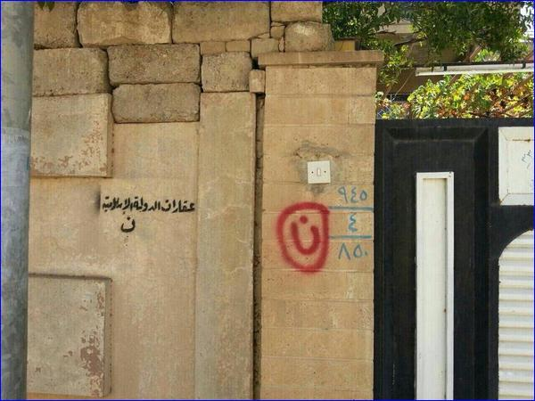

Slide 3
拿撒勒人耶穌的跟隨者 Followers of Jesus from Nazareth

Slide 4
啟示錄七教會 Seven Churches of Revelation
以弗所 Ephesus
士每拿 Smyrna
別迦摩 Pergamum
推雅推喇 Thyatira
撒狄 Sardis
非拉鐵非 Philadelphia
老底嘉 Laodicea

Slide 5
John 1:29
²⁹ The next day John saw Jesus coming toward him and said, “Look, the Lamb of God, who takes away the sin of the world!
Matthew 11:3
³ to ask him, “Are you the one who is to come, or should we expect someone else?”
John 1:29
²⁹ 次日，約翰看見耶穌來到他那裏，就說：「看哪，上帝的羔羊，除去世人罪孽的！
Matthew 11:3
³ 問他說：「那將要來的是你嗎？還是我們等候別人呢？」

Slide 6
1. 肯定你的選擇正確 (7) Affirm Your Choice is Correct
Revelation 3:7
⁷ 「你要寫信給非拉鐵非教會的使者，說：『那聖潔、真實、拿著大衛的鑰匙、開了就沒有人能關、關了就沒有人能開的，說：
⁷ “To the angel of the church in Philadelphia write: These are the words of him who is holy and true, who holds the key of David. What he opens no one can shut, and what he shuts no one can open.

Slide 7
Hosea 11:9
⁹ 因我是神，並非世人， 是你們中間的聖者；
Revelation 6:10
¹⁰ 大聲喊著說：「聖潔真實的主啊，你不審判住在地上的人，給我們伸流血的冤，要等到幾時呢？」
Hosea 11:9
⁹ For I am God, and not a man— the Holy One among you.
Revelation 6:10
¹⁰ They called out in a loud voice, “How long, Sovereign Lord, holy and true, until you judge the inhabitants of the earth and avenge our blood?”

Slide 8
1. 肯定選擇正確 (7) Affirm Your Choice is Correct
Revelation 3:7
⁷ 「你要寫信給非拉鐵非教會的使者，說：『那聖潔、真實、拿著大衛的鑰匙、開了就沒有人能關、關了就沒有人能開的，說：
⁷ “To the angel of the church in Philadelphia write: These are the words of him who is holy and true, who holds the key of David. What he opens no one can shut, and what he shuts no one can open.

Slide 10
1. 肯定你的選擇正確 (7) Affirm Your Choice is Correct
Revelation 3:7
⁷ 「你要寫信給非拉鐵非教會的使者，說：『那聖潔、真實、拿著大衛的鑰匙、開了就沒有人能關、關了就沒有人能開的，說：
⁷ “To the angel of the church in Philadelphia write: These are the words of him who is holy and true, who holds the key of David. What he opens no one can shut, and what he shuts no one can open.

Slide 11
Acts 4:12
¹² 除他以外，別無拯救；因為在天下人間，沒有賜下別的名，我們可以靠著得救。」
¹² Salvation is found in no one else, for there is no other name under heaven given to mankind by which we must be saved.”

Slide 13
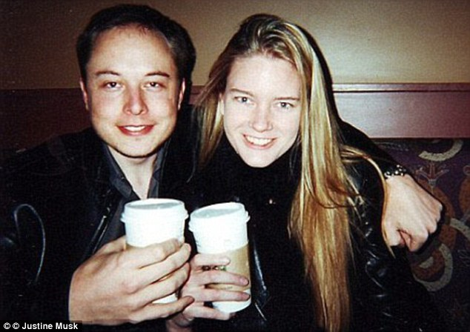

Slide 14
2. 肯定你的工作忠誠 (8) Affirm Your Work is Faithful
Revelation 3:8
⁸ 我知道你的行為，你略有一點力量，也曾遵守我的道，沒有棄絕我的名。看哪，我在你面前給你一個敞開的門，是無人能關的。
⁸ I know your deeds. See, I have placed before you an open door that no one can shut. I know that you have little strength, yet you have kept my word and have not denied my name.

Slide 16
Hebrews 11:36–39 又有人忍受戲弄、鞭打、捆鎖、監禁、各等的磨煉，³⁷ 被石頭打死，被鋸鋸死，受試探，被刀殺，披著綿羊、山羊的皮各處奔跑，受窮乏、患難、苦害，³⁸ 在曠野、山嶺、山洞、地穴，飄流無定，本是世界不配有的人。 ³⁹ 這些人都是因信得了美好的證據
³⁶ Some faced jeers and flogging, and even chains and imprisonment. ³⁷ They were put to death by stoning; they were sawed in two; they were killed by the sword. They went about in sheepskins and goatskins, destitute, persecuted and mistreated—³⁸ the world was not worthy of them. They wandered in deserts and mountains, living in caves and in holes in the ground. ³⁹ These were all commended for their faith

Slide 17
3. 肯定你的獎賞 (8-12) Affirm Your Reward
Revelation 3:8
⁸ 我知道你的行為，你略有一點力量，也曾遵守我的道，沒有棄絕我的名。看哪，我在你面前給你一個敞開的門，是無人能關的。
⁸ I know your deeds. See, I have placed before you an open door that no one can shut. I know that you have little strength, yet you have kept my word and have not denied my name.

Slide 18
3. 肯定你的獎賞 (8-12) Affirm Your Reward
肯定進天國 Guarantee entering God’s kingdom
還你清白 Vindicate your innocence
Revelation 3:9
⁹ 那撒但一會的，自稱是猶太人，其實不是猶太人，乃是說謊話的
⁹ I will make those who are of the synagogue of Satan, who claim to be Jews though they are not, but are liars

Slide 19
3. 肯定你的獎賞 (8-12) Affirm Your Reward
肯定進天國 Guarantee entering God’s kingdom
還你清白 Vindicate your innocence
使你的敵人降服Make your enemy subjected to you
Revelation 3:9
⁹ … 我要使他們來，在你腳前下拜
⁹ … I will make them come and fall down at your feet

Slide 20
3. 肯定你的獎賞 (8-12) Affirm Your Reward
肯定進天國 Guarantee entering God’s kingdom
還你清白 Vindicate your innocence
使你的敵人降服Make your enemy subjected to you
使你的敵人承認神愛你Make your enemy acknowledge God has loved you

Slide 21
Revelation 3:9
⁹ … 也使他們知道我是已經愛你了。
⁹ … and acknowledge that I have loved you.

Slide 22
3. 肯定你的獎賞 (8-12) Affirm Your Reward
肯定進天國 Guarantee entering God’s kingdom
還你清白 Vindicate your innocence
使你的敵人降服Make your enemy subjected to you
使你的敵人承認神愛你Make your enemy acknowledge God has loved you
我要保護你 I will protect you

Slide 23
Revelation 3:10
¹⁰ 你既遵守我忍耐的道，我必在普天下人受試煉的時候，保守你免去你的試煉。
¹⁰ Since you have kept my command to endure patiently, I will also keep you from the hour of trial that is going to come on the whole world to test the inhabitants of the earth.

Slide 24
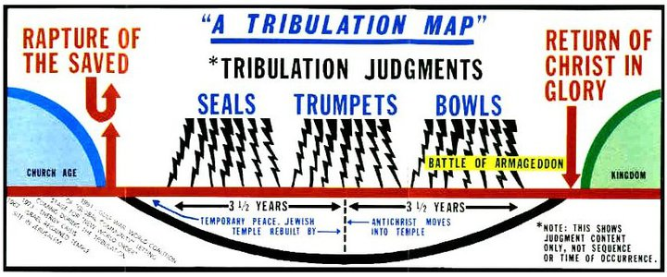
教會被提 Church Rapture

Slide 25
Revelation 3:11
¹¹ 我必快來，你要持守你所有的，免得人奪去你的冠冕。
¹¹ I am coming soon. Hold on to what you have, so that no one will take your crown.

Slide 26
3. 肯定你的獎賞 (8-12) Affirm Your Reward
肯定進天國 Guarantee entering God’s kingdom
還你清白 Vindicate your innocence
使你的敵人降服Make your enemy subjected to you
使你的敵人承認神愛你Make your enemy acknowledge God has loved you
我要保護你 I will protect you
我要作你的保障 I will become your security

Slide 27
Revelation 3:12
¹² 得勝的，我要叫他在我上帝殿中作柱子，他也必不再從那裏出去。
¹² The one who is victorious I will make a pillar in the temple of my God. Never again will they leave it.

Slide 28
3. 肯定你的獎賞 (8-12) Affirm Your Reward
肯定進天國 Guarantee entering God’s kingdom
還你清白 Vindicate your innocence
使你的敵人降服Make your enemy subjected to you
使你的敵人承認神愛你Make your enemy acknowledge God has loved you
我要保護你 I will protect you
我要作你的保障 I will become your security
你是屬於我的 You belong to me

Slide 29
Revelation 3:12
¹² 我又要將我上帝的名和我上帝城的名（這城就是從天上、從我上帝那裏降下來的新耶路撒冷），並我的新名，都寫在他上面。
¹² I will write on them the name of my God and the name of the city of my God, the new Jerusalem, which is coming down out of heaven from my God; and I will also write on them my new name.

Slide 31
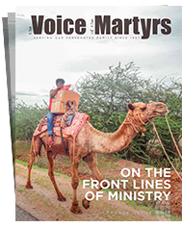
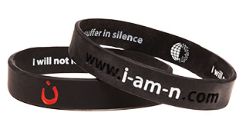

Slide 32
Hebrews 13:3
³ 你們要記念被捆綁的人，好像與他們同受捆綁；也要記念遭苦害的人，想到自己也在肉身之內。
³ Continue to remember those in prison as if you were together with them in prison, and those who are mistreated as if you yourselves were suffering.

